Slide 2
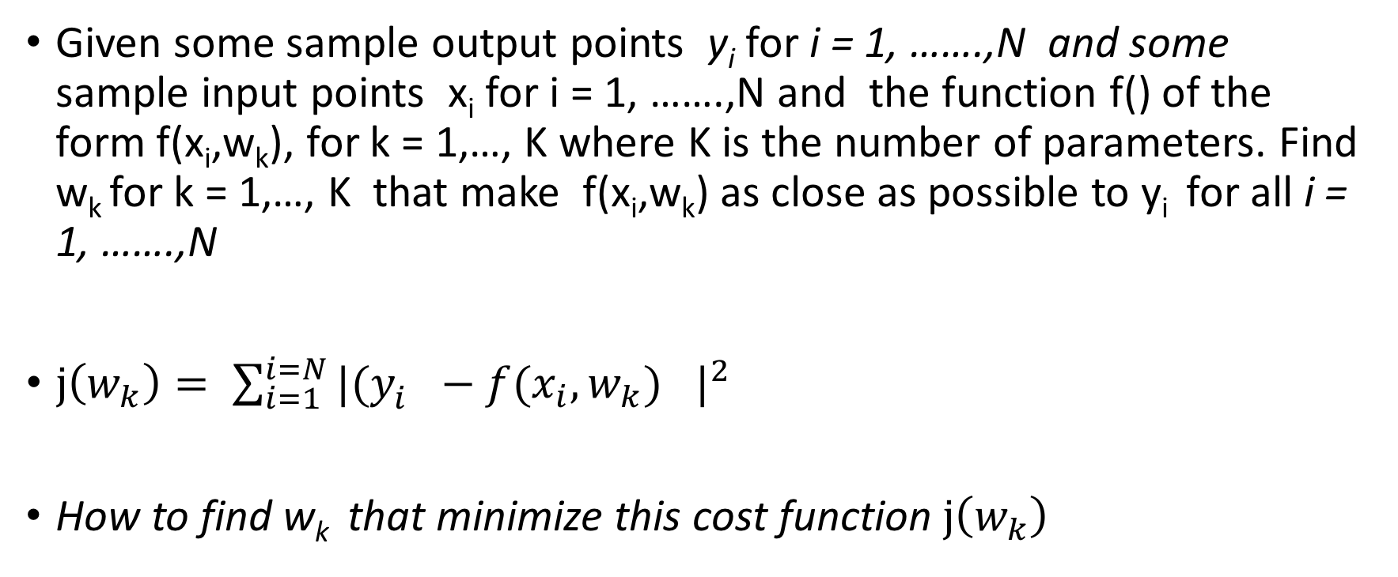
Optimization in the context of machine learning
Given some sample output points y_{i} for i = 1, …….,N and some sample input points x_{i} for i = 1, …….,N and the function f() of the form f(x_{i},w_{k}), for k = 1,…, K where K is the number of parameters. Find w_{k} for k = 1,…, K that make f(x_{i},w_{k}) as close as possible to y_{i} for all i = 1, …….,N
$j\left(w_{k}\right)= \sum_{i=1}^{i=N}{{|(y_{i}^{}−{f(x_{i},w_{k})}_{}^{}|}^{2}}$
How to find w_{k} that minimize this cost function $j\left(w_{k}\right)$

Slide 3
Finding minia of j(w_{k})

Slide 4
Finding minia of j(w_{k})

Slide 5
Assumption
Let assume the cost function is f(x) where x is some parameters.
How to find the best x that minimizes the cost function?

Slide 6
Rate of change in derivative

Slide 8
Finding minia

Slide 12
Learning rate solves this jumping behavior

Slide 18
